Slide 1


UTA EE LABS
Using IR to Transmit and Receive data

Slide 2
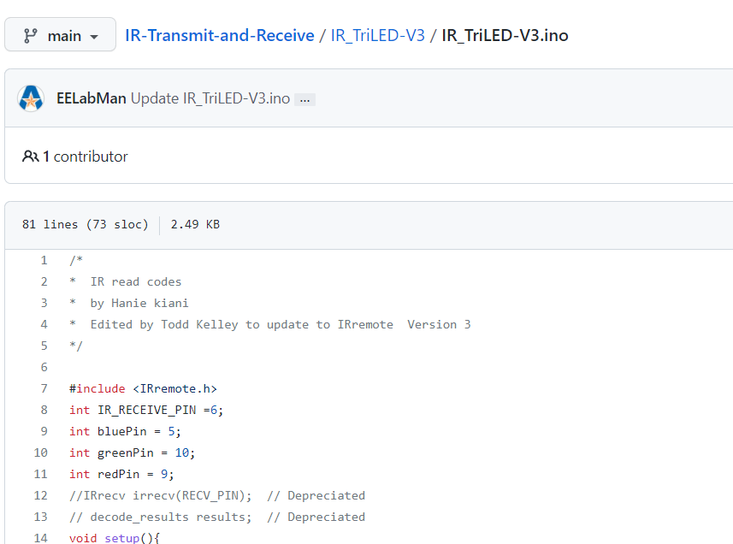
Code and PowerPoint is downloadable from GitHub
https://github.com/EELabMan
Go to Repositories -> IR-Transmit-and-Receive For PowerPoint and code

Slide 3
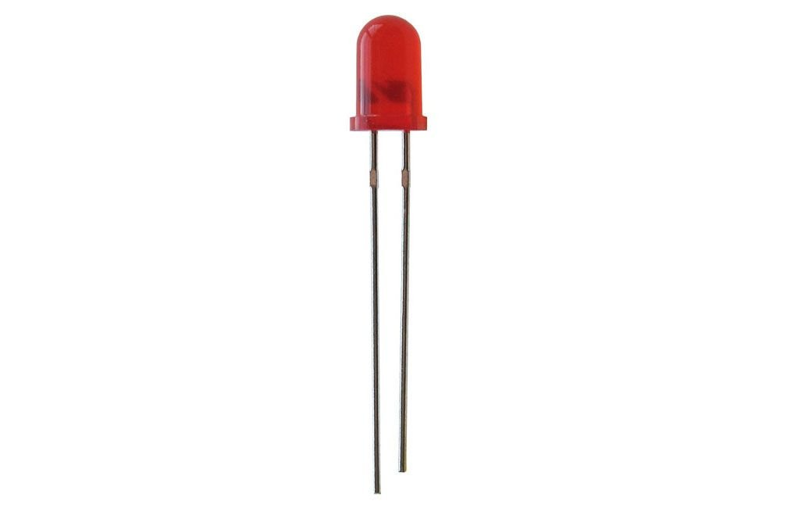
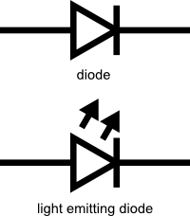
LED Basics
Common 5mm LED
The LED is a very low energy light source
Anode
Cathode
+
-

Slide 4
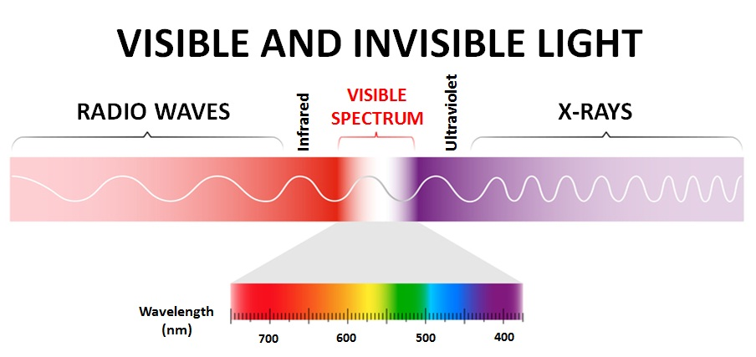
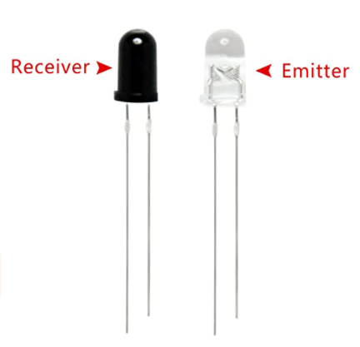
IR LED’s

Slide 5
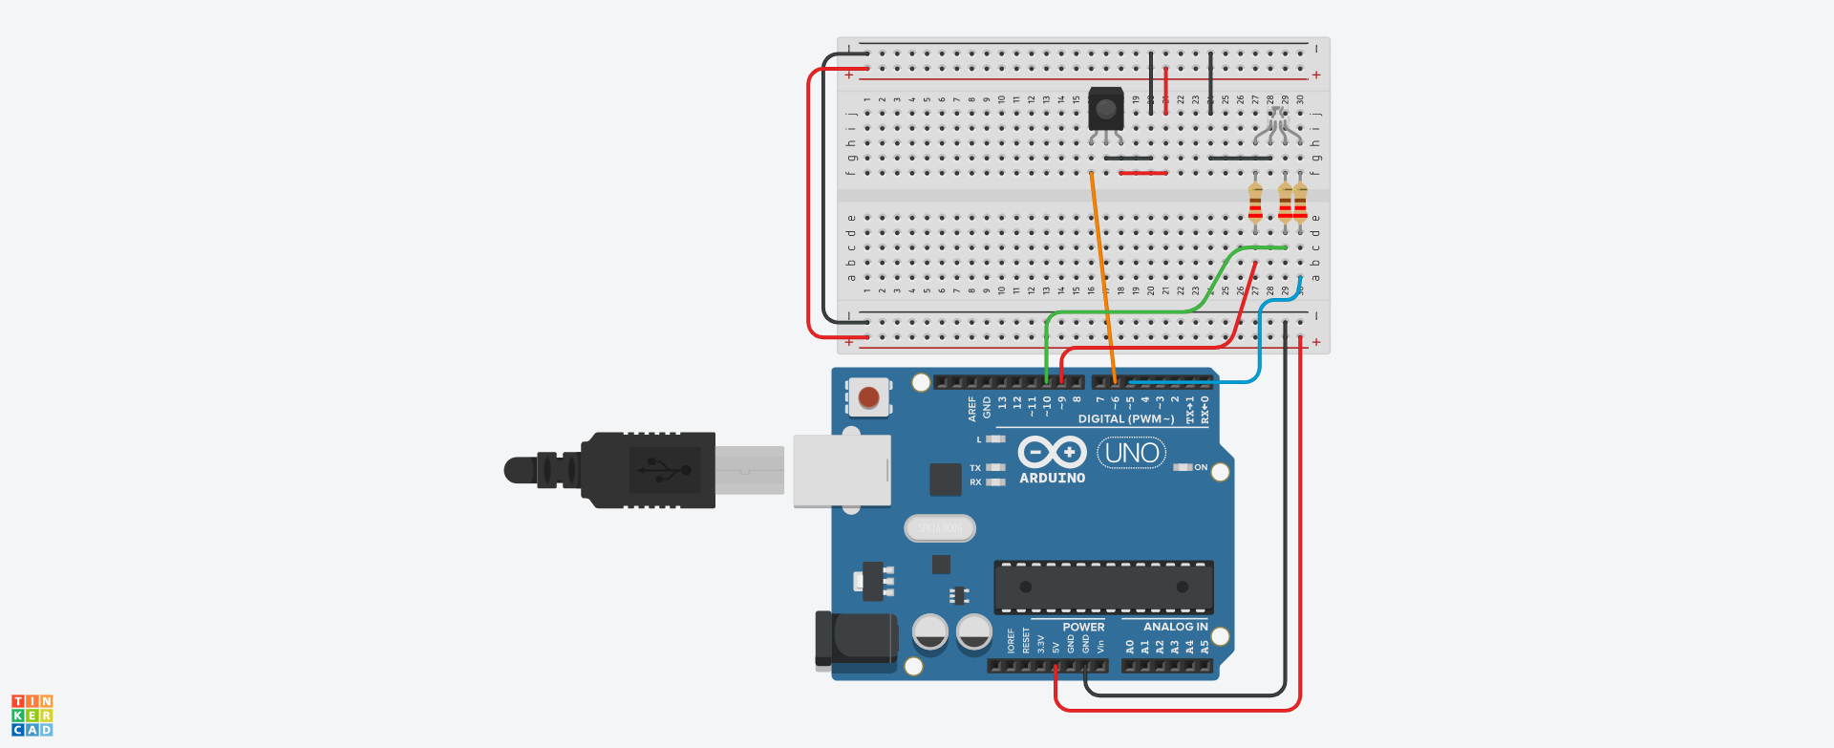
Let’s build the Receiver circuit

Slide 6
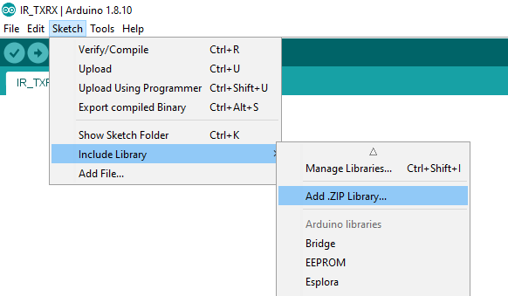
Arduino Libraries
We need to include a library to make our IR work.
Download the following zip file from https://downloads.arduino.cc/libraries/github.com/z3t0/IRremote-3.4.0.zip
Save it to Documents\Arduino\Libraries
Do not unzip.
Add from Sketch->Include Library-> Add .ZIP Library.

Slide 7
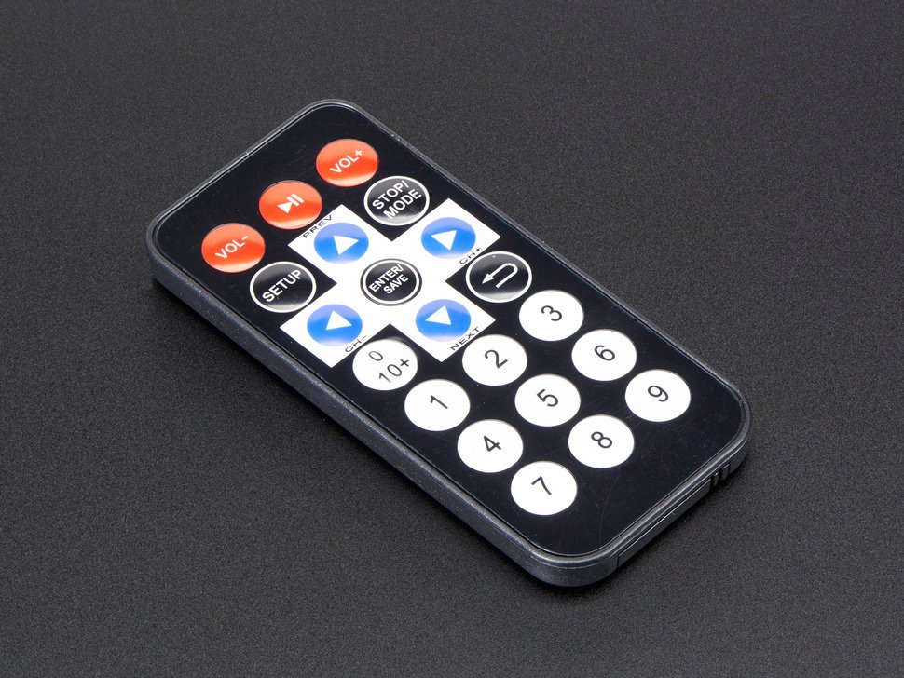
Upload the code and Test
Copy the IR_TriLED-V3.ino from github and paste it into a blank Arduino sketch.
Pressing 1 on the remote should turn on the Red LED
Pressing 2 on the remote should turn on the Green LED
Pressing 3 on the remote should turn on the Blue LED
Pressing 4-9 will have different colors
Pressing Stop/Mode will turn the LED off

Slide 8
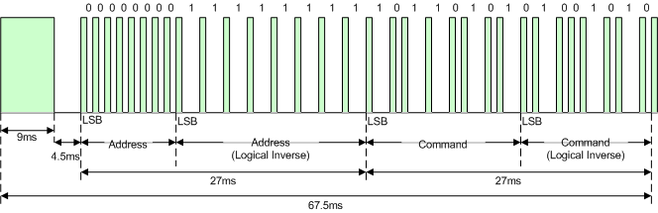
IR Transmit
Use a different Arduino Uno and Breadboard to build the TX. We will still use the IR RX Uno and breadboard. We will power it from a battery or wall wart.
Download IR_TX.ino from github and upload.
Notice it is modified from the RGB Nightlight.ino. We just send codes over IR instead of setting the RGB values.
Modulated at 38KHz.

Slide 9
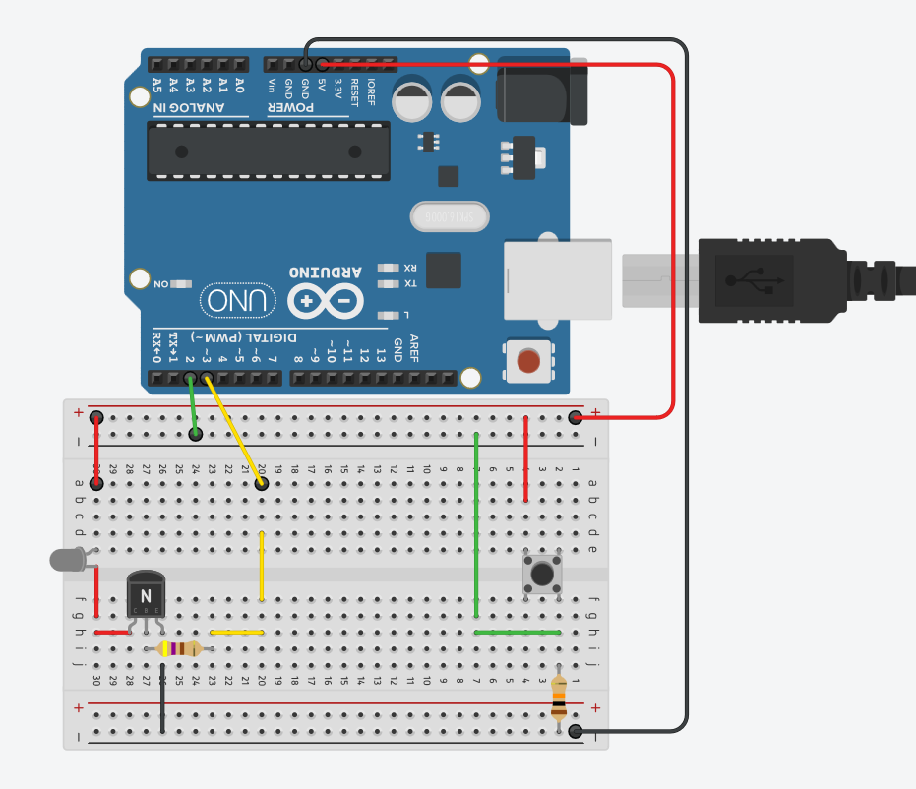
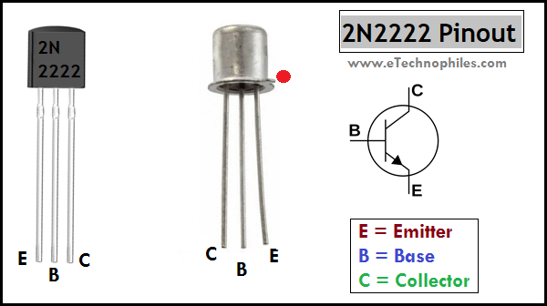
IR Transmit
Power Down the Arduino and build the circuit.

Slide 10
IR TX/RX on Oscilloscope
Measure TX on Channel 1 and RX on Channel 2
Measure logic
going to Pin 6
Measure logic coming from Pin 3

Slide 11
IR Transmit and Receive
This should very close to our signals.

Slide 12
Questions?
In what ways might this be useful?

